Slide 1

Demand Forecasting using Machine Learning Algorithms
MECHANICAL ENGINEERING DEPARTMENT
ME7195D Project (Part – II)
Under the guidance of
Dr. R Sridharan
Professor (HAG)
Rounak Singh Buttar
M210533ME

Slide 2
Feedback from panel members
Sr.No. | Feedback/Suggestions/Corrections | How it is addressed/Justified
1 | Add a slide showing the screenshot of the code submitted for the public repository. | The screenshot has been attached.
2 | Snippet of the code can be attached. | The screenshot has been attached.
3 | How many data points are required? | Minimum two for every period.
4 | Attach exploratory data analysis slides. | Added.

Slide 3
Objective
RO1: Predict the sales of a retail store using different machine learning algorithms and determine the best algorithm.
RO2: Implement traditional regression techniques as well as advanced boosting techniques and compare their performance.

Slide 4
METHODOLOGY
Obtain data from the organisation
Exploratory Data Analysis
Data Pre-processing
Feature Engineering
Loop
Segregation of Training and Testing data
Prediction using training data
Performance analysis of prediction using test data and performance metrics
Predict the sales of the products using the best algorithm

Slide 5
Machine Learning Algorithms and Statistical Methods to be used
Multiple regression
Lasso Regression
Ridge Regression
Gradient Boosting
AdaBoost
XGBoost
ARIMA
Holt Winter’s

Slide 6
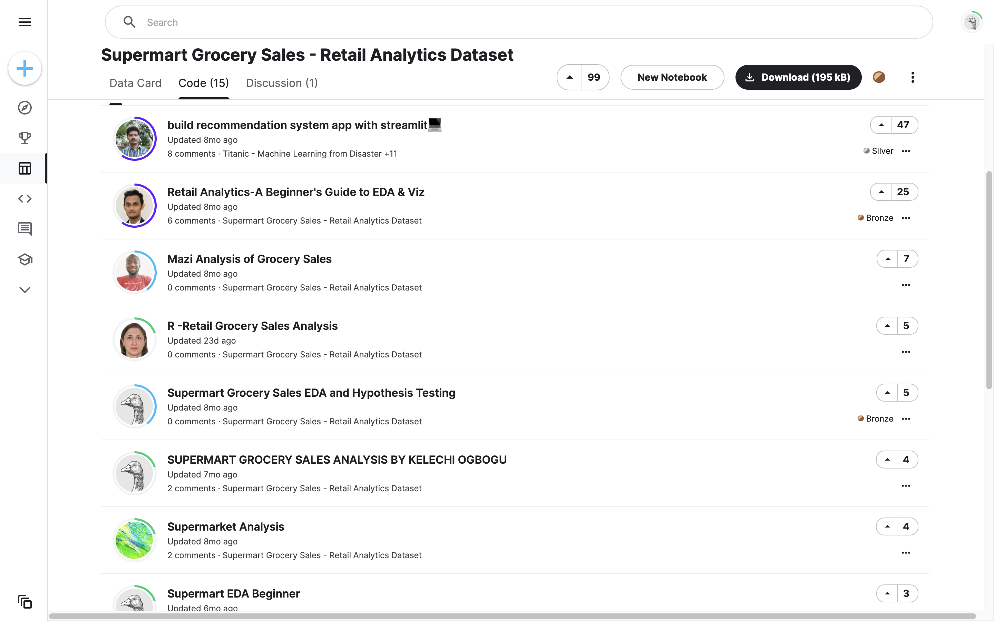

Slide 7
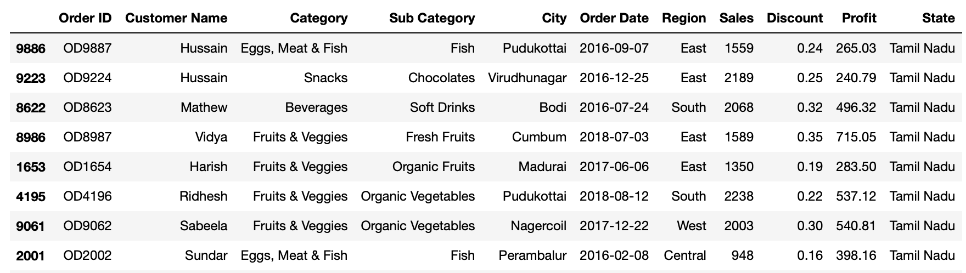
Data Transformation

Slide 8
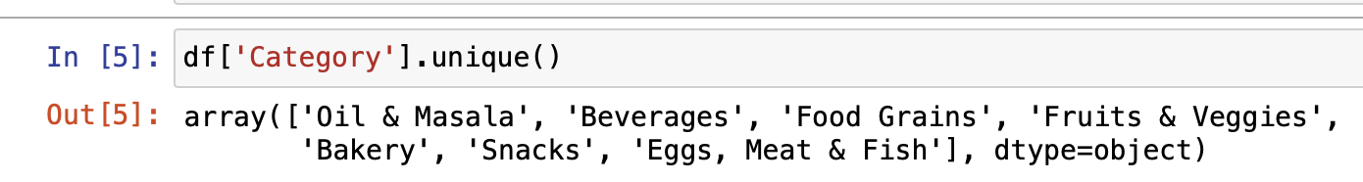
Data Transformation
Finding out the different product categories.

Slide 9
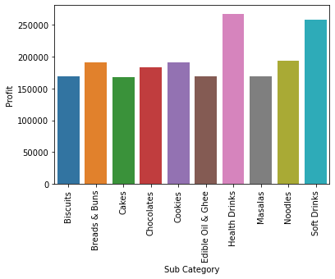
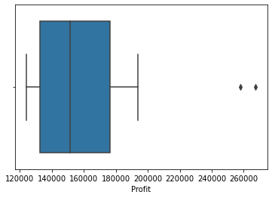
Exploratory Data Analysis
Finding the outlier

Slide 10
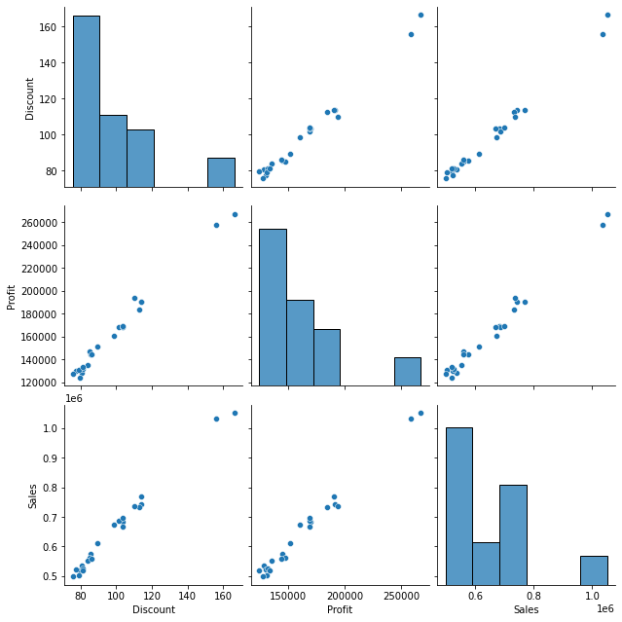
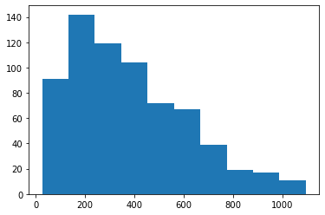
Sales (in Rs) histogram

Slide 11
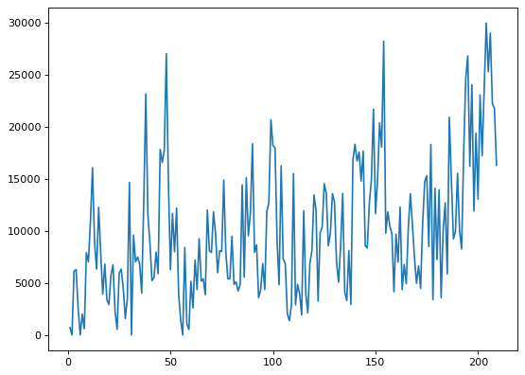
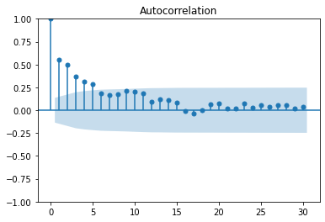
Weekly Sales of Beverages
ACF

Slide 12
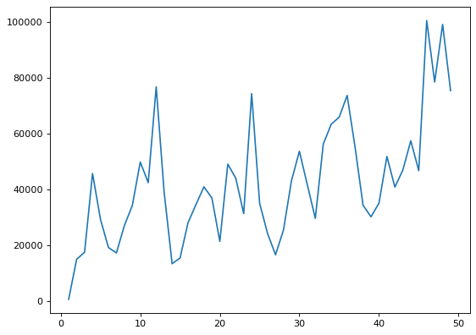
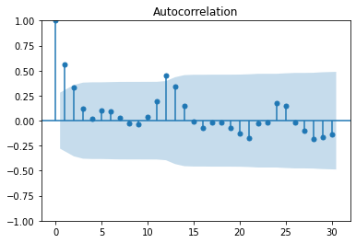
Monthly Sales of Beverages
ACF

Slide 13
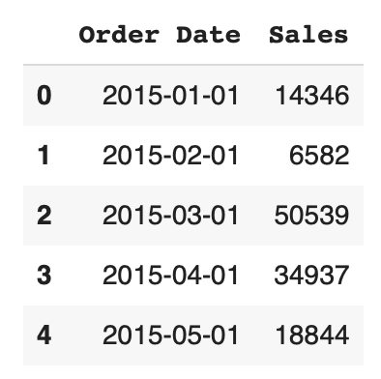
Data Transformation
For each product category, we create a subset of the dataframe, sum up the sales in each month.
We now have our data ready in the required timeseries format.

Slide 14
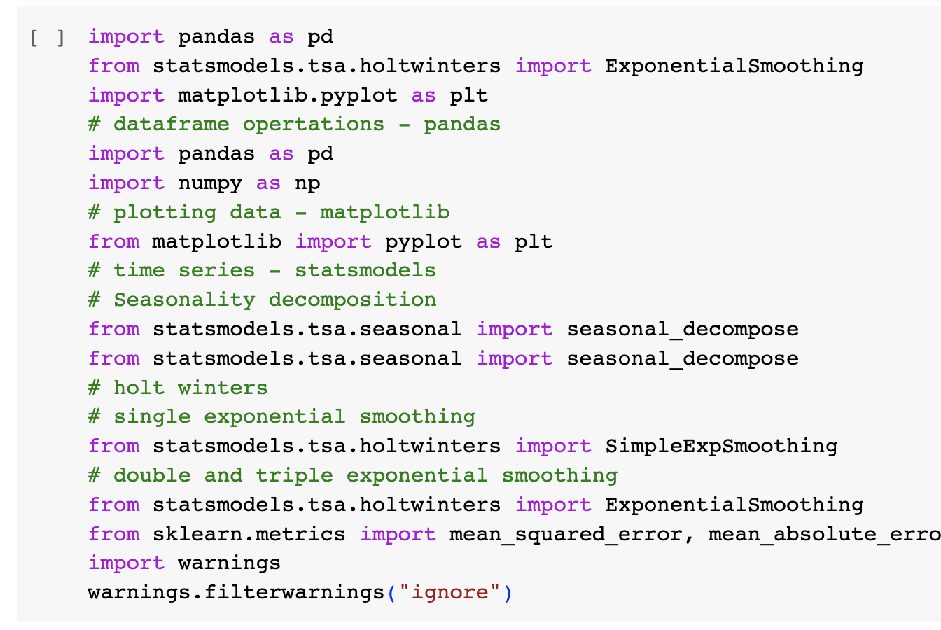

Slide 15
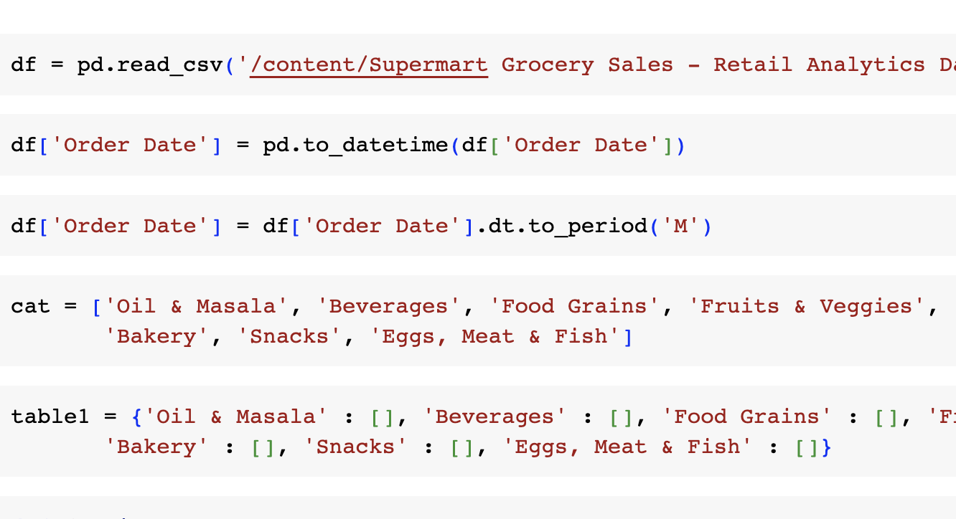

Slide 16
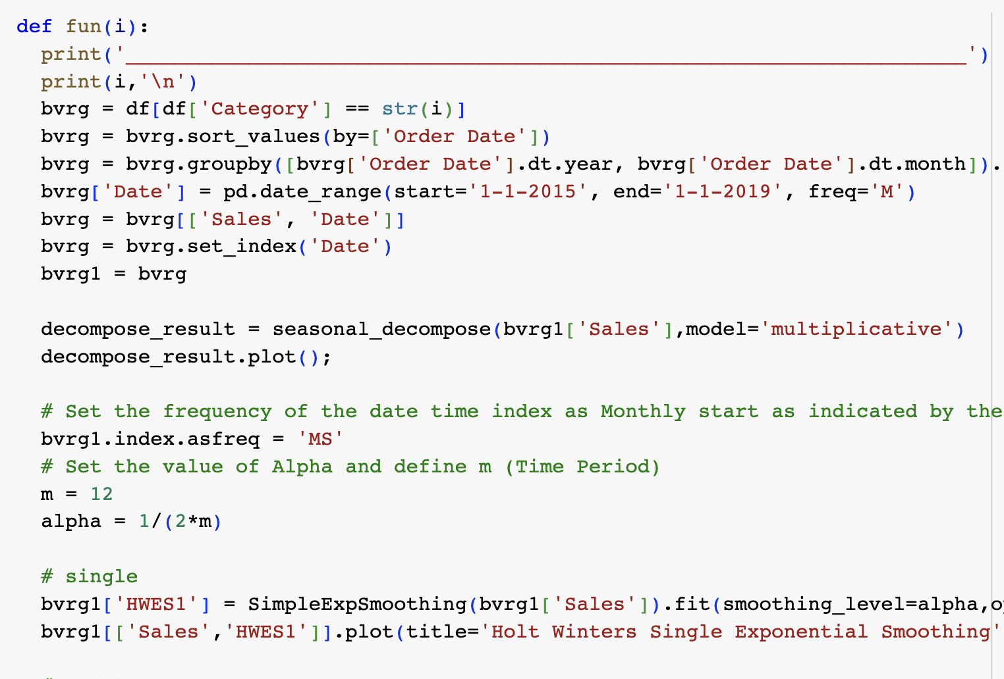

Slide 17
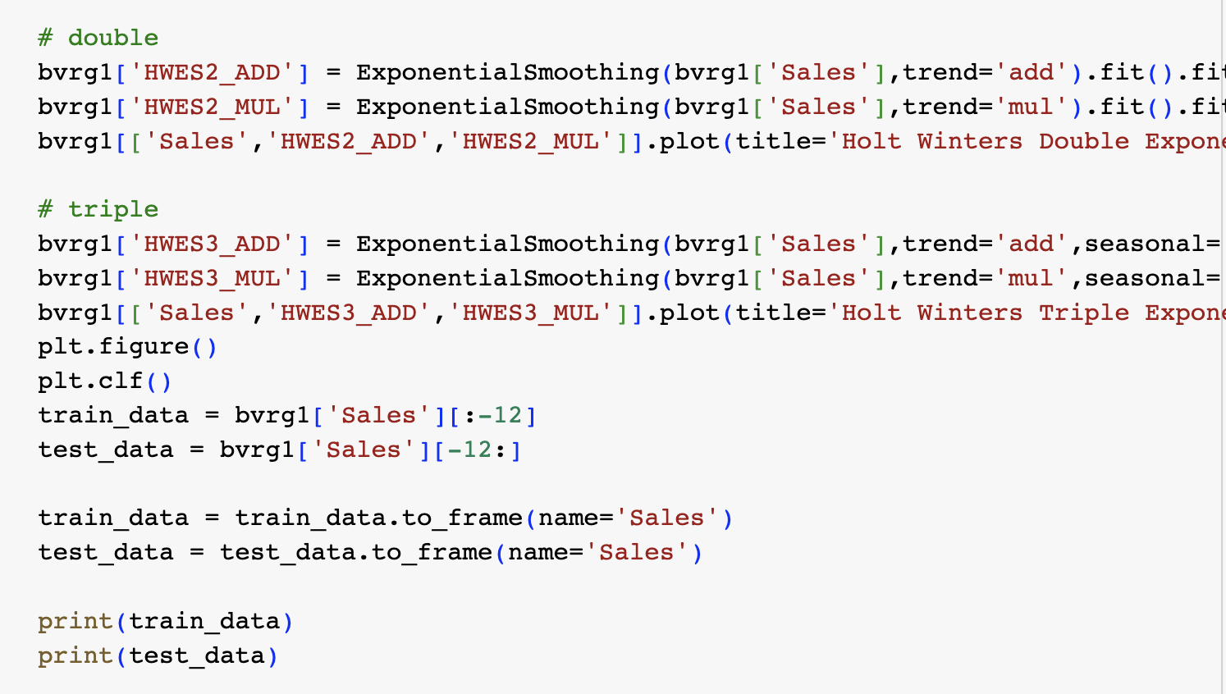

Slide 18
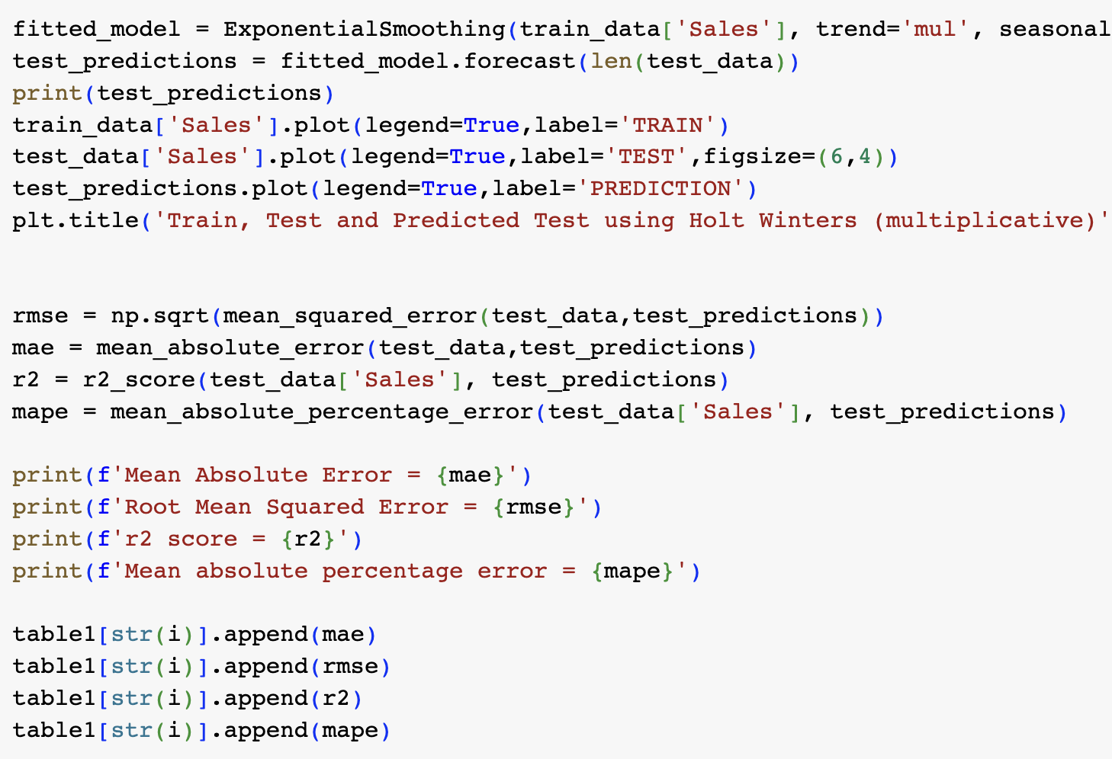

Slide 19
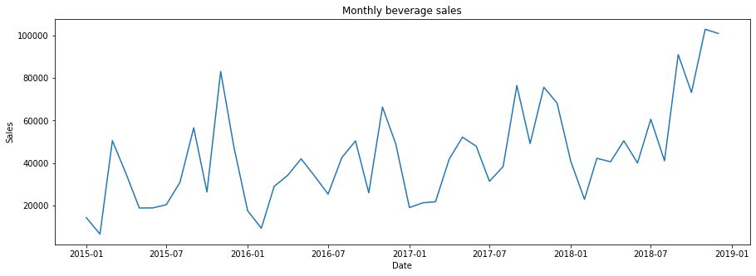
Visualisation of monthly sales

Slide 20
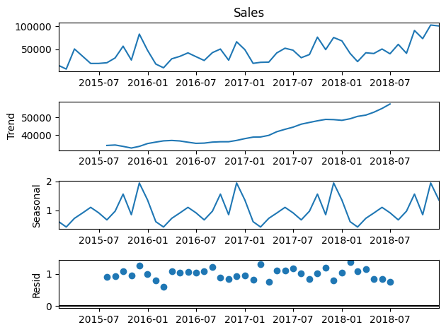

Slide 21
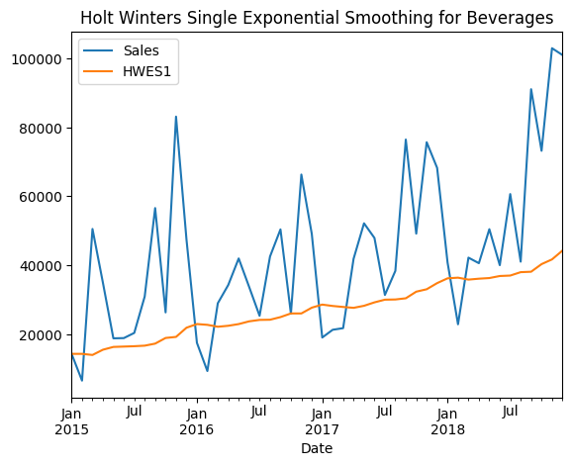

Slide 22
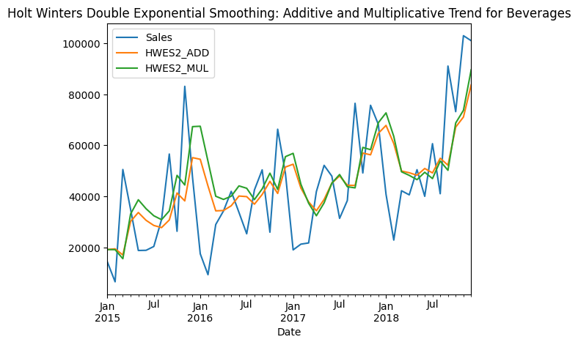

Slide 23
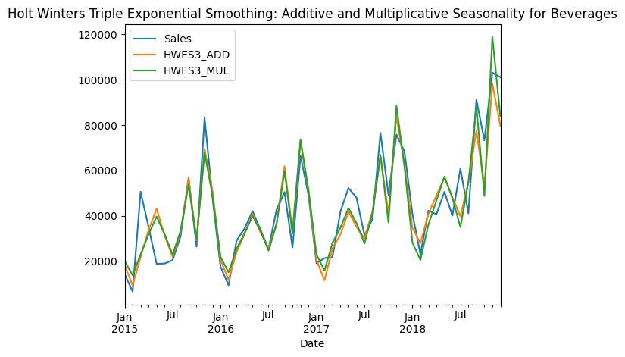

Slide 24
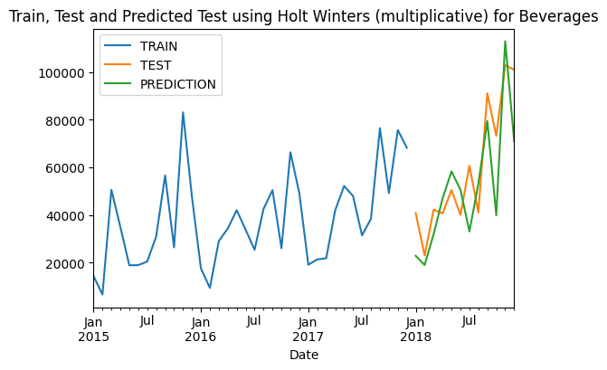

Slide 25
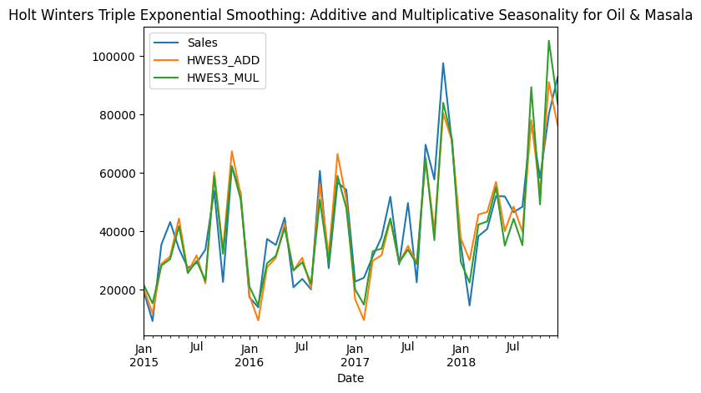

Slide 26
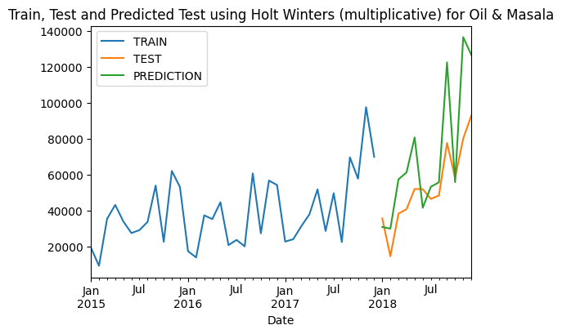

Slide 27
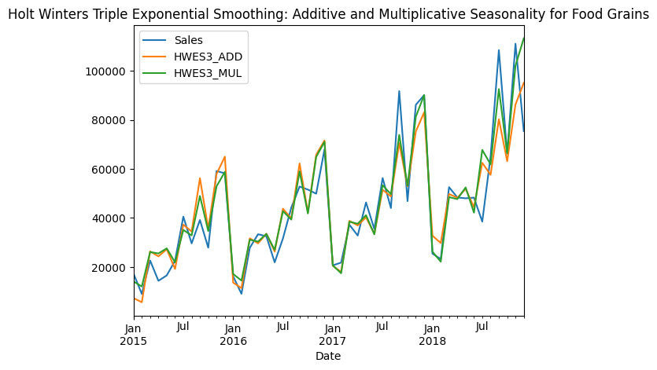

Slide 28
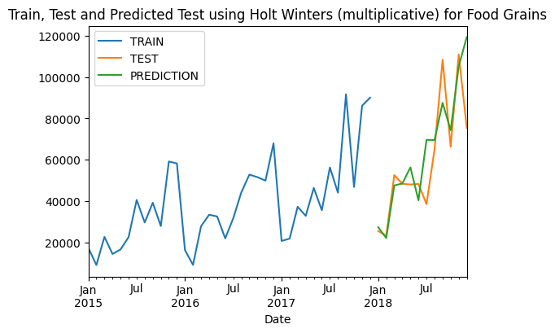

Slide 29
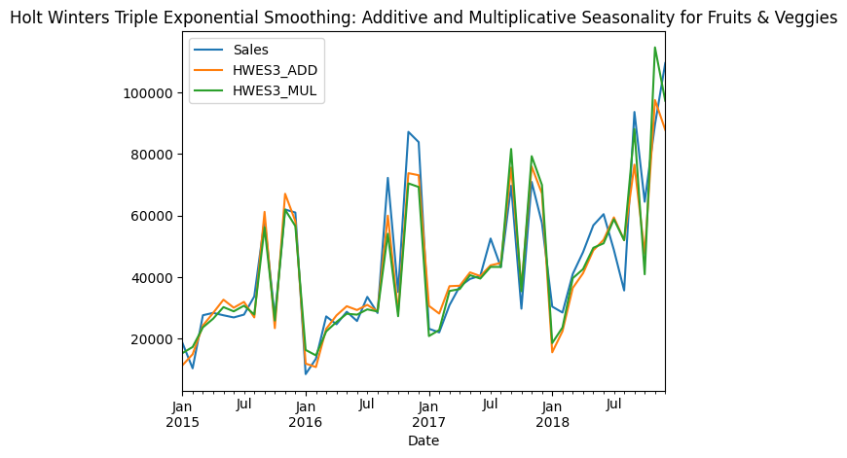

Slide 30
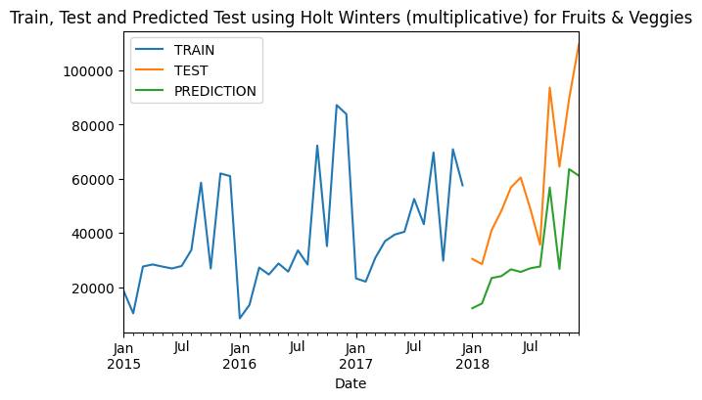

Slide 31
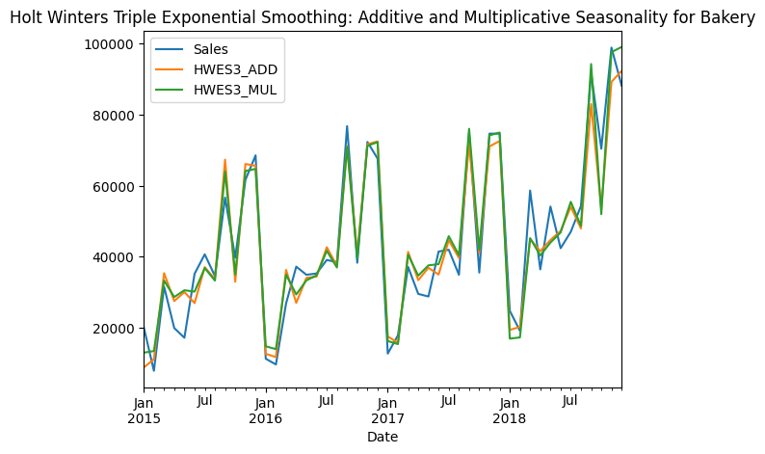

Slide 32
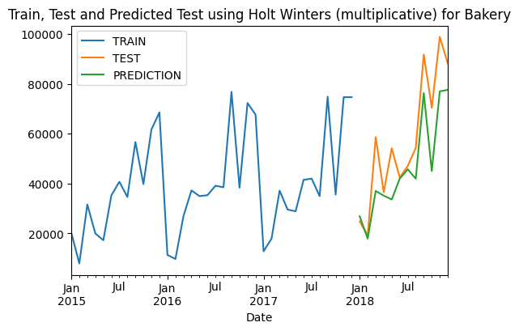

Slide 33
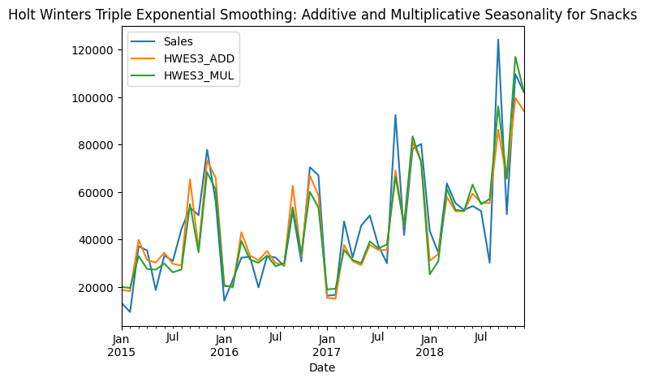

Slide 34
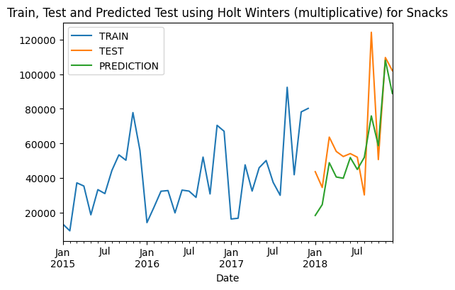

Slide 35
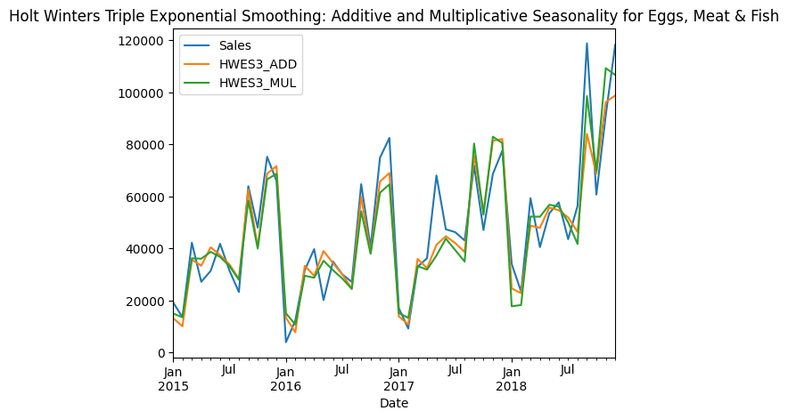

Slide 36
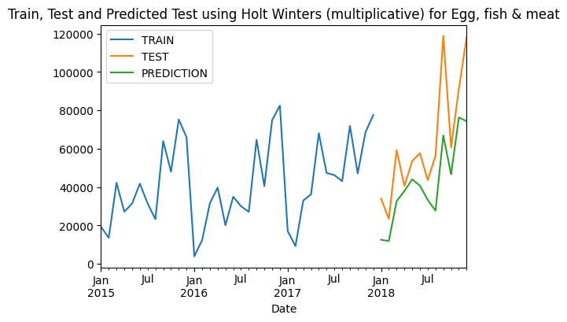

Slide 37
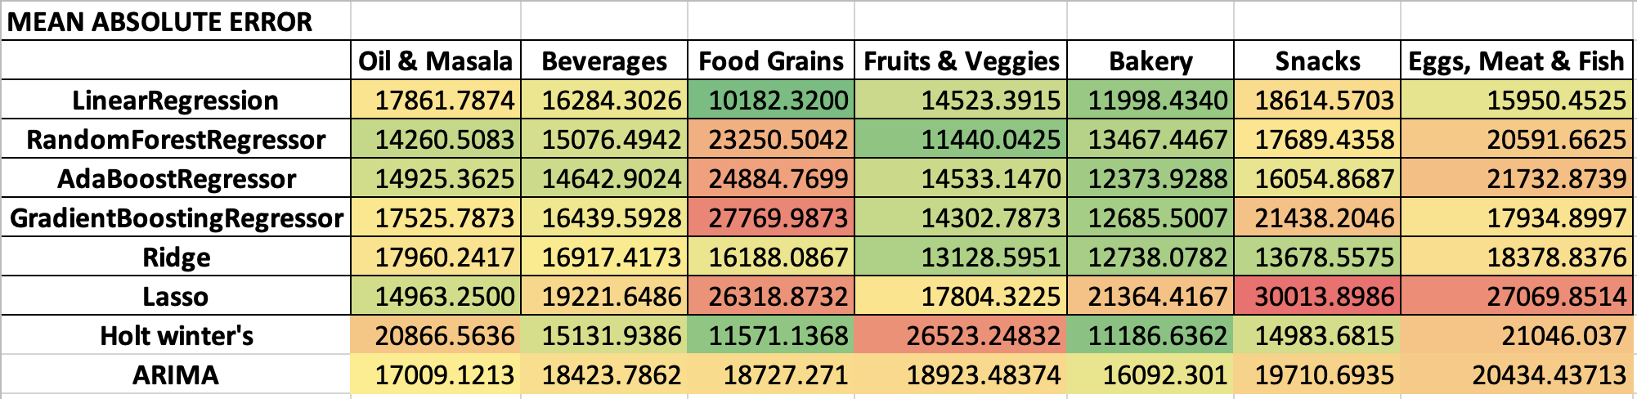
Results

Slide 38
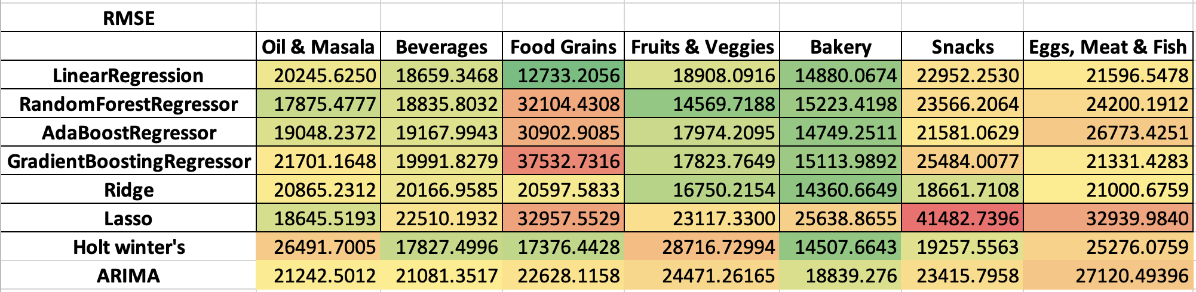
Results

Slide 39
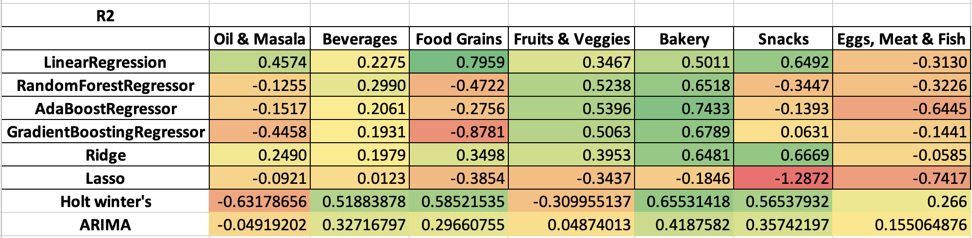
Results

Slide 40
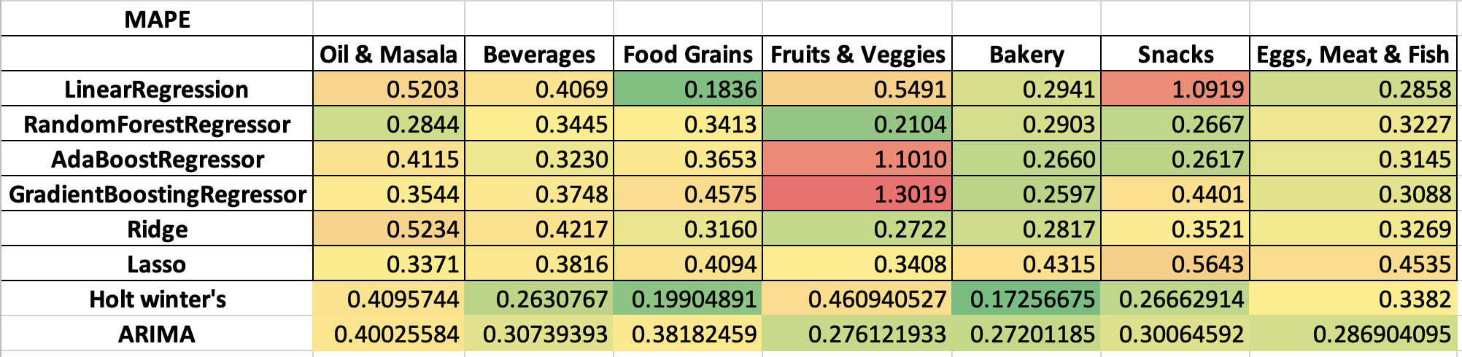
Results

Slide 41
Additional course work done
Global Online Certification Course on
Data-Driven Supply Chain Transformation 2022
launched by NITIE, Mumbai and IIT(BHU), Varanasi (under PM Gati Shakti Scheme) in collaboration with world-renowned scientist Prof. David Simchi-Levi (Professor Business & Supply Chain Analytics Director, Director of Data Science Lab, MIT)

Slide 42
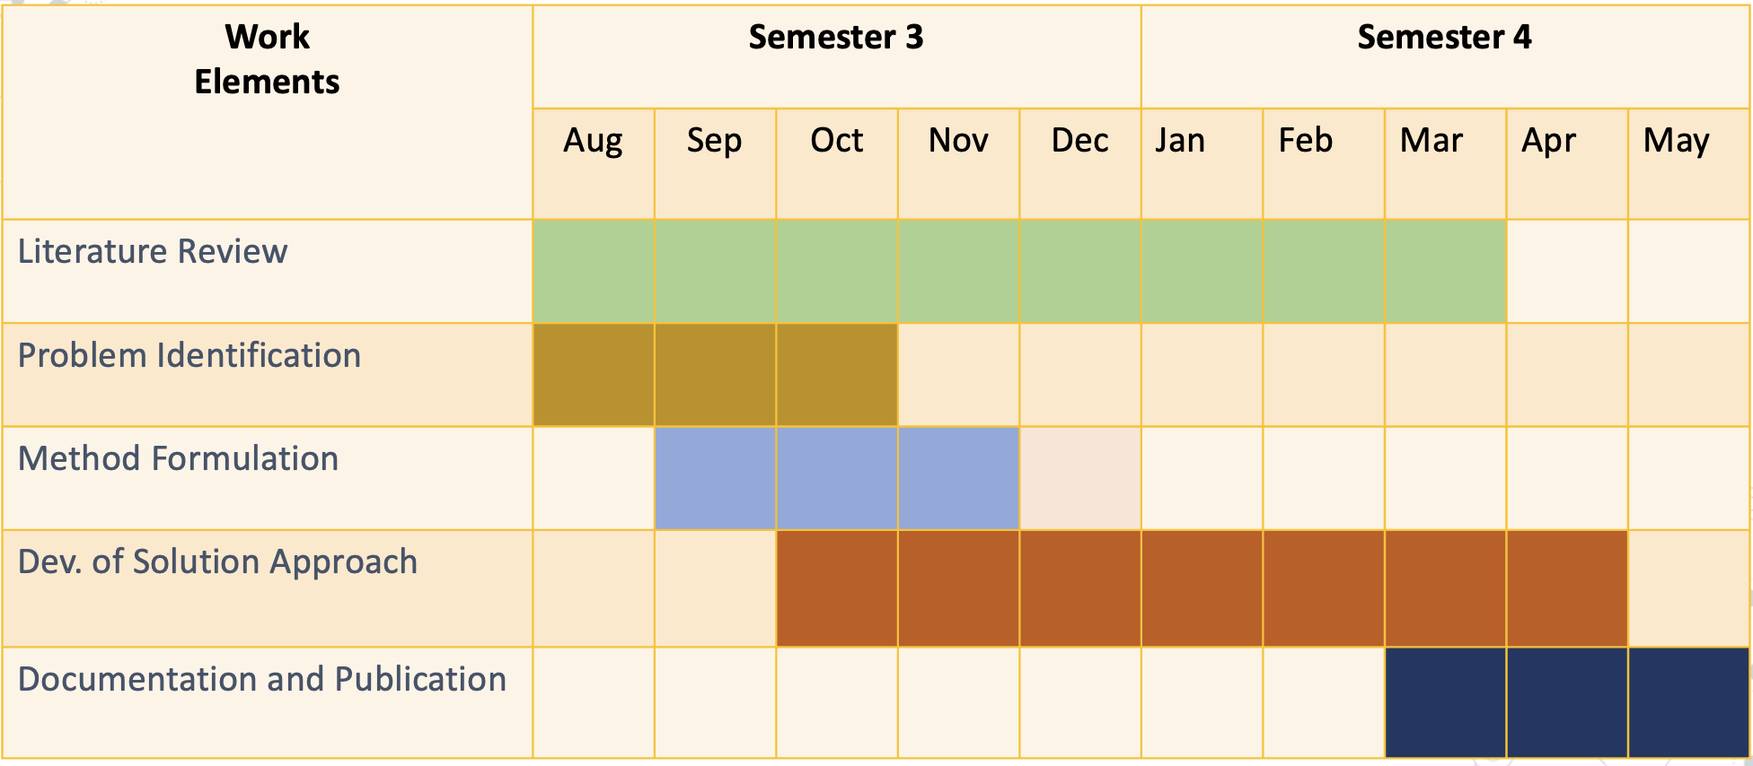
Project Timeline

Slide 43
Scope for future work
Improved forecasting methods including deep learning, ensemble methods or hybrid models could be applied.
High frequency and real time forecasting.
Automated forecasting from data preprocessing to model selection & evaluation.

Slide 44
References
Barksdale, H.C., Hilliard, J.E., 1975. A cross-spectral analysis of retail inventories and sales. Journal of Business 48 (3), 365–382.
Krishna, A., Akhilesh, V., Aich, A. and Hegde, C., 2018, December. Sales-forecasting of retail stores using machine learning techniques. In 2018 3rd International Conference on Computational Systems and Information Technology for Sustainable Solutions (CSITSS) (pp. 160-166). IEEE.
Cheriyan, S., Ibrahim, S., Mohanan, S. and Treesa, S., 2018, August. Intelligent sales prediction using machine learning techniques. In 2018 International Conference on Computing, Electronics & Communications Engineering (iCCECE) (pp. 53-58). IEEE.
Mortensen, S., Christison, M., Li, B., Zhu, A. and Venkatesan, R., 2019, April. Predicting and Defining B2B Sales Success with Machine Learning. In 2019 Systems and Information Engineering Design Symposium (SIEDS) (pp. 1-5). IEEE.

Slide 45
Thank you

